Slide 1
Chapter One
Introduction to Enterprise System and Application

Slide 2




Instructor Profile
Name
Contact
Liam Lei
Email: liamli@ipm.edu.mo
Phone: (853) 8599 6577
Office: Room A303, Chi-Un Building

Slide 3
Course information
Lecture Times:
Tuesday 14:30 – 17:30
Assessment:
Laboratory(20%), Test(5%), Assignment(25%), Exam(50%)
Class Rules:
Don't cheat, Don't play games, don't watch videos, etc.

Slide 4
What do you expect from this course?
Introduction to the Enterprise Level Systems and Applications
Middleware Development
Framework Development
Server-side Resource Management
Database Development and Management
Enterprise Cybersecurity

Slide 5
Recommended Reading Materials

Slide 6


What is the Enterprise Computing?
An organization (company, charity,
Government Department / Agency)
the use of computers to process
data or perform calculations

Slide 7
What is the Enterprise Computing?
involves the use of computers in networks, such as LANS and WANs, or a series of interconnected networks that encompass a variety of different operating systems, protocols, and network architectures.

Slide 8
What is enterprise computing?
Enterprise computing is about combing separate applications, services, and process into unified system that is greater than the sum of its parts.
Enterprise computing is usually seen as a collection of big business software solutions to common problems such as resource management and streamlining processes.
People study the common problems (business values) and provide solutions (product, platform, framework, service, etc.)

Slide 9
Enterprise Computing demystified
Enterprise computing usually takes place in a heterogeneous(異構) network.
https://en.wikipedia.org/wiki/Lists_of_network_protocols
A variety of server applications run on top of the heterogeneous network hardware.
Enterprise computing involves the use of many different network protocols and standards.
Enterprise computing involves many different roles (manager, architect, administrator, developer, analyst, operator, support, etc.) for different areas (solution, system, database, network, data, quality assurance, etc.).

Slide 10
Which enterprise needs enterprise computing?
Types of enterprises include:
Retail
Manufacturing
Service
Wholesale
Government
Educational
Transportation
etc.
Notes:
零售： 京東，淘寶
製造：汽車製造
服務： 酒店
批發： 進銷存系統
政府：電子政務
教育：校園系統
運輸：民航，海運，快遞

Slide 11
(computer) Information System
An information system (IS) is a formal, sociotechnical, organizational system designed to collect, process, store, and distribute information.
From a sociotechnical perspective, information systems are composed by four components: task, people, structure (or roles), and technology.
A computer information system is a system composed of people and computers that processes or interprets information.

Slide 12
(computer) Information System
People may classify information systems with different perspectives:
Size: mosquito, small, large, elephant, etc.
Architecture: standalone, client-server, web-based, cloud-based, etc.
Functionality: front-end interfaces, middle bridging, back-end housekeeping, etc.
Transaction Type: online transactions and offline transactions
Frequency: all time (real-time monitoring, etc.), fixed time (stock trading, etc.), periodic (monthly statements, quarterly results, etc.), occasionally (ad-hoc reports, etc.)
Notes:
Online and offline debit transactions

Slide 13
Enterprise information systems
An Enterprise Information System (EIS) is any kind of information system which improves the functions of enterprise business processes by integration. This means typically offering high quality of service, dealing with large volumes of data and capable of supporting some large and possibly complex organization or enterprise.
--Wikipedia
Enterprise Information Systems (EIS) are large-scale application software packages that support business processes, information flows, reporting, and data analytics in complex organizations.
People simply define EIS as a combination of many information systems.

Slide 14
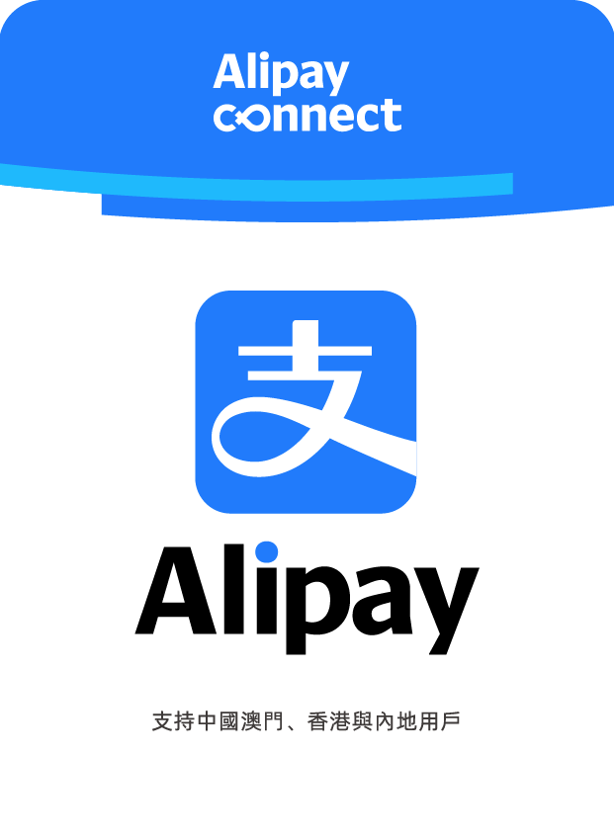

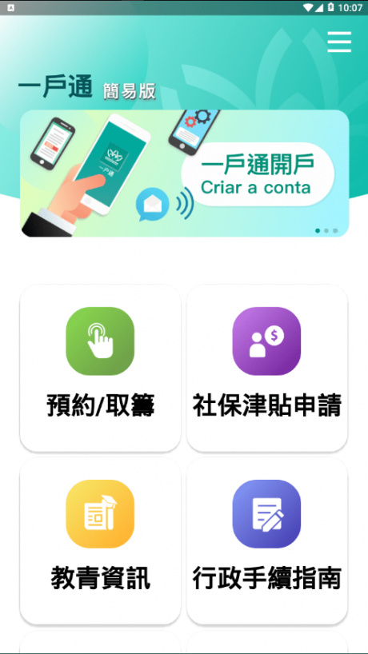
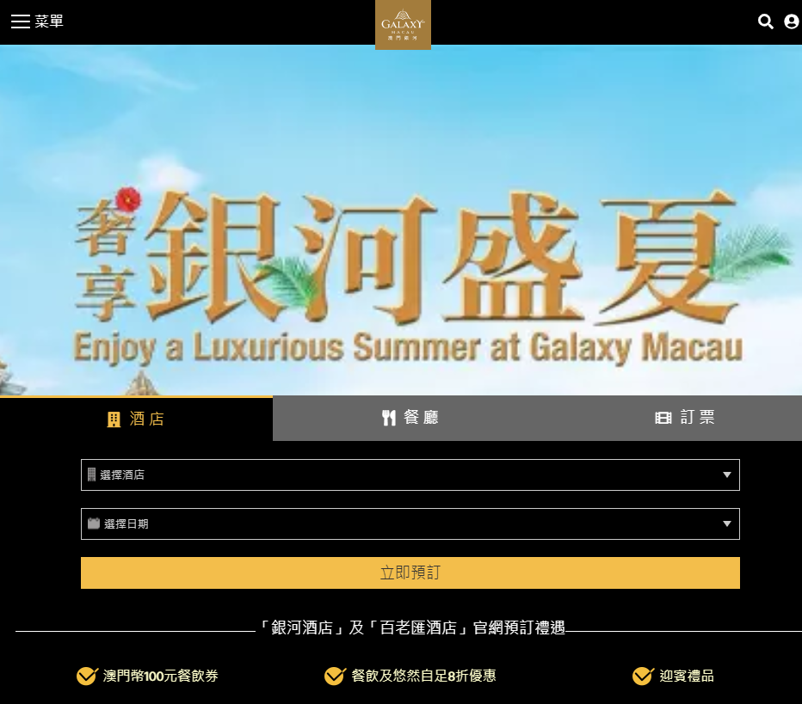
Enterprise Information Systems
Enterprise level systems in Macao:
Governmental Departments (Citizen Information Management)
Banks (Legacy Systems, Online Banking Systems, Modern Transaction Channels, Reporting Systems, etc.)
Resorts (hotels, casinos, entertainments, shopping, F&B, etc.)

Slide 15

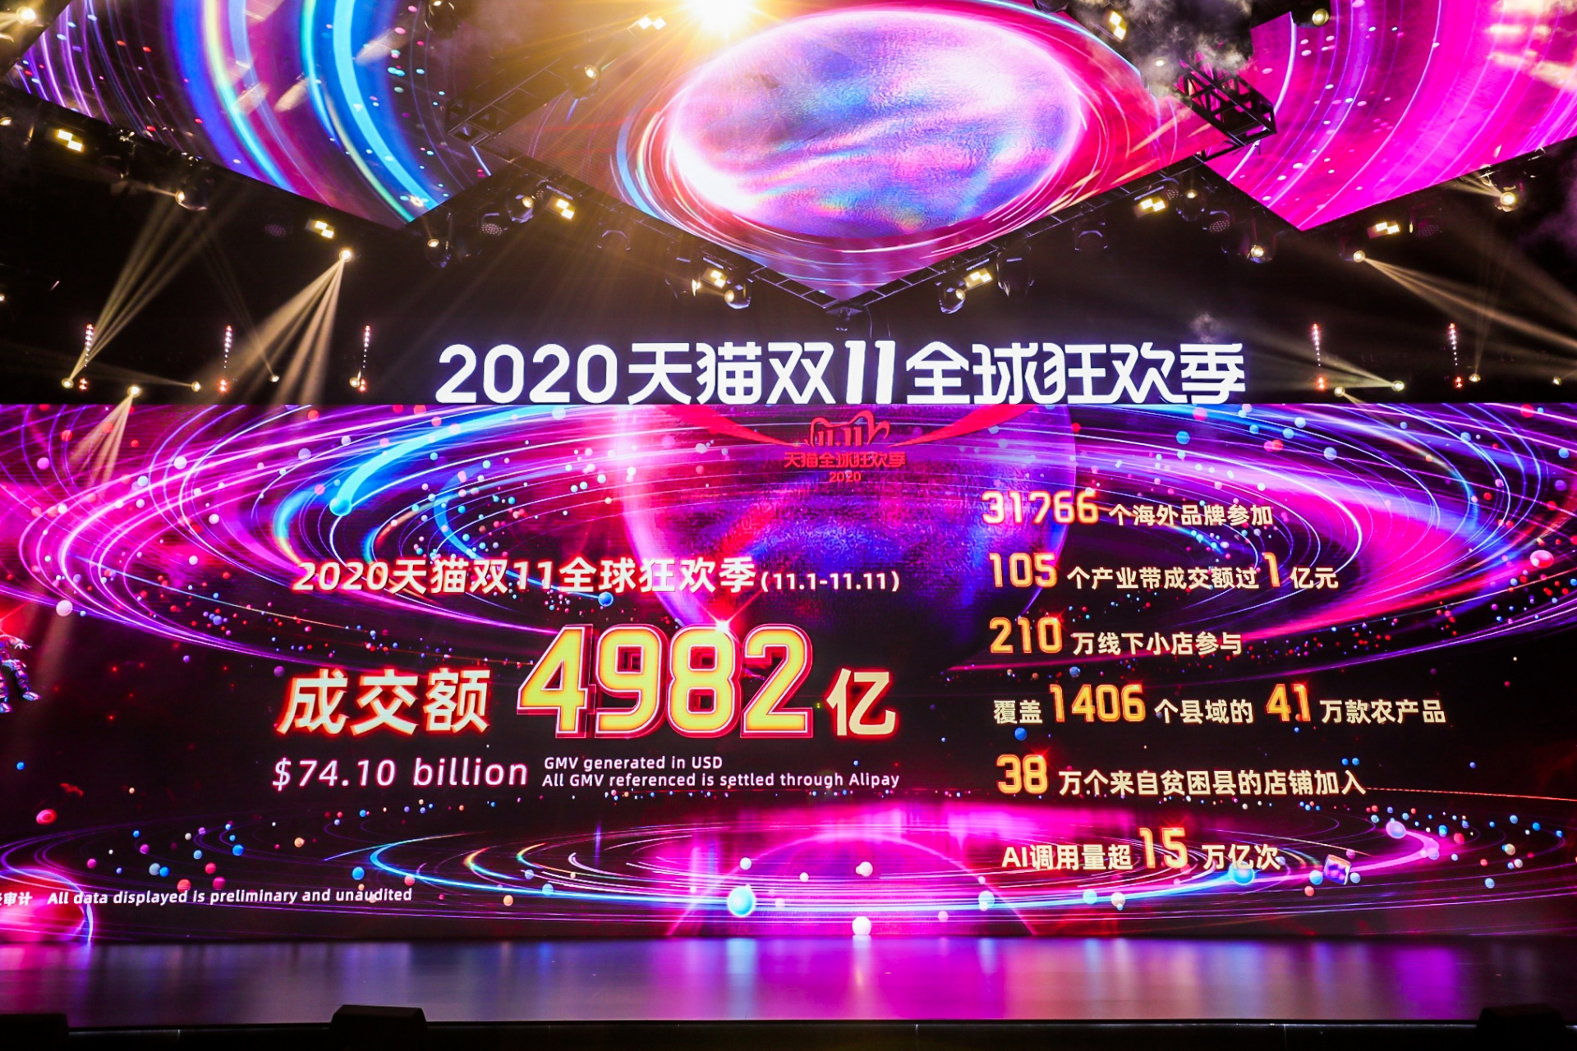
It is all about size
Alibaba has made the peak trading reached 583k transactions / sec. and RMB 498.2 billion in sales on the Singles’ Day (2020-11-11) with over 2.25 billion transactions.
There were 0.82 billion “Wei-Xin Red Envelope” sent or received via WeChat (by Tencent) on the Chinese New Year period (2019).
Wikipedia has about 4.9 million articles, 36.6 million pages and 25.5 million registered users.

Slide 16
Common EIS platform
Legacy Systems (close platform)
IBM AS/400 (Government, Banks, Resorts)
IBM Mainframe zSeries(Banks)
Slot Accounting System, SAS (Resorts)
Commercial Systems (open platform)
Advanced Interactive eXecutiveAIX (Linux, Unix, Debian, Ubuntu, etc.)
Windows based eServer System (IBM, HP, DELL, etc.)
Modern Virtual System (virtual or cloud platform)
Allocate hardware resources dynamically:
CPU, RAM, and disk space for virtual servers
Create environment (operating system and software) with profiles:
Profile 1: Linux, Apache Tomcat, MySQL, PHP Engine, etc.
Profile 2: Windows Server, GlassFish, SQLServer, JDK, etc.
Other Profiles…

Slide 17
EIS Machine Pictures
AS/400
QSAM file
Mainframe
CICS
QSAM and VSAM files
Notes:
The QSAM (queued sequential access method) file system supports fixed, variable, and spanned records. Using the QSAM file system, you can directly access a QSAM file that you transferred from the mainframe to AIX

Slide 18
EIS Machine Pictures(cont.)
AIX, eServer
Linux, Unix, Windows
Data Center
Enterprise Servers
Data Storage
Servers Backup

Slide 19
Enterprise application software (EAS)
Enterprise applications software (EAS) are about the display, manipulation, and storage of large amounts of often complex data and the support or automation of business processes with that data.
---Martin Fowler
EAS is computer software used to satisfy the needs of an organization rather than individual users.
EAS is an integral part of a (computer-based) information system; a collection of such software is called an enterprise information system.
Enterprise
Applications
Software
(EAS)
Enterprise
Applications
Software
(EAS)
Enterprise
Information
System
(EIS)
Enterprise
Applications
Software
(EAS)

Slide 20
Popular Enterprise Applications
Automated Billing System
Business Intelligence (BI)
Content Management System (CMS)
Customer Relationship Management (CRM)
Enterprise Application Integration (EAI)
Enterprise Forms Automation
Enterprise Resource Planning (ERP)
Human Resource Management (HRM)
Interactive Product Catalogue
Key Performance Indicator (KPI)
Online Shopping and payment processing.

Slide 21
Common Gaming Systems
Gaming Systems
Gaming Accounting System
Gaming Report System
Backend Integration Management System
World-wide Player Checking System
Cage Operation System
Slot Machine Management System
Gaming Systems
Marketing Kiosk
Gaming Rule Kiosk
Baccarat Display System
Roulette Display System
Player Card Management System
Player Reward System
Gift Promotion Mobile Application
etc.

Slide 22
Common Non-Gaming Systems
Non-Gaming Systems
Global Document
Staff Learning & Training
Source Control
Human Resources (HR)
Wine Inventory
Procurement
Point of Sale (POS)
Digital Signage
Signature, Passport OCR Capture
Non-Gaming Systems
Performance Monitoring
Limousine Tracking
Incident and Log
Hotel Room Reservation
Internal Wire
F&B Booking
Hotel Housekeeping
Hotel Property (Opera)
Financial & Payment
etc.

Slide 23
Computer Software:
Application Software:
E-mail
Word processor
Spreadsheet
Web browser
etc.
Enterprise system:
ERP
CRM
SCM
etc.
Used in
building an
Information
system
System Software:
Middleware
Database
Operating System, etc
Notes:
An Enterprise system is type software package.

Slide 24
Characteristics of Enterprise Level Systems and Applications
High Performance
Able to provide rapid transaction time even in peak hours.
Able to process massive amount of transactions concurrently.
Stable & Robustness
Server running consistently and correctly as expected under any kinds of legal and illegal operations.
Constantly amend and improve to prevent loopholes.
System environmental upgrade to fix potential problems.
Resilience Control
Anti-virus, malicious software prevention.
Power supply shortage.
Notes:
不断修正和完善，防止漏洞(loopholes)。
彈性控制：
惡意軟件預防（malicious software）

Slide 25
Characteristics of Enterprise Level Systems and Applications (cont.)
Cost Effectiveness
Short development effort but high profitable product.
Extensible & Flexible
Ease of further development and integration with others.
Disaster Recovery (DR)
Data & software backup and recovery mechanism.
Data Centers and DR sites are required.
High Availability (HA)
Provide almost zero downtime services (24 x 7).
Load balancing, failover, virtual servers, etc.

Slide 26
Characteristics of Enterprise Level Systems and Applications (cont.)
Resource Management and Optimization
Database, application servers, operating system, network optimization.
Standardization & Documentation
Provide enough documents (system handbooks, operational guidelines, administration whitepaper, etc.) to explain the system.
Acquire the industrial International Organization for Standardization (ISO) to reduce operational risks, maintain high quality of services and secure to achieve industrial standard level.
Code of Practice for staffs to follow the operational procedures.

Slide 27
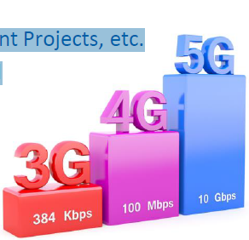
The trend of EIS
1980s
AS/400 Applications
Token ring connection and Internet is not widely use in commercial areas
1990s
Mainframe Applications
Starts to use Internet with 56kbit/s speed
2000s
Web Applications, Data Warehouse Projects, Business Intelligent Projects, etc.
Local ISP provides leased line for companies with Mbit/s speed
2010s
Cloud Computing, Big Data, Visualization, Mobile App, etc.
Local ISP provides fiber optic network with Gbit/s speed
Possibilities in 2020s
Blockchain, IoT, AI agents, Smart Applications, microservices, etc.
Local ISP provides wireless network with Gbit/s speed

Slide 28
Application architectures
A Brief Introduction

Slide 29
Computing system
What is computing system?
Computing system is defined as the combination of hardware, software, user and data --Wikipedia
Computing system is a collection of entities(hardware, software and liveware) that are designed to receive, process, manage and present information in a meaningful format. --https://peda.net/

Slide 30
Computing system
Data storage
Input
Processing
Output

Slide 31
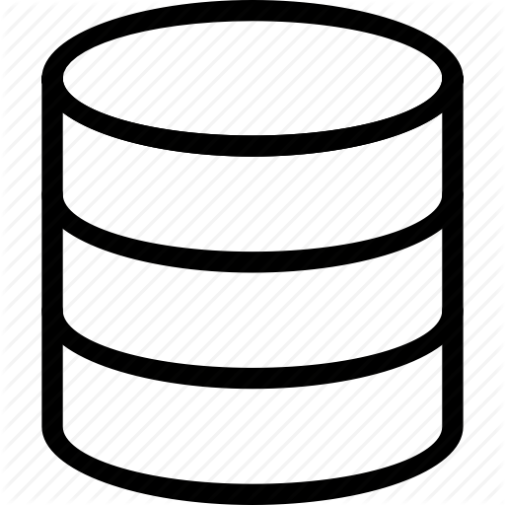
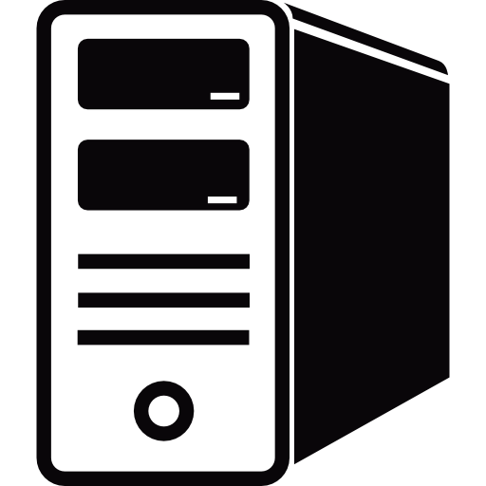

Application Architectures
The basic functions of an application software:
Data storage and data access
Application logic
Presentation logic

Slide 32
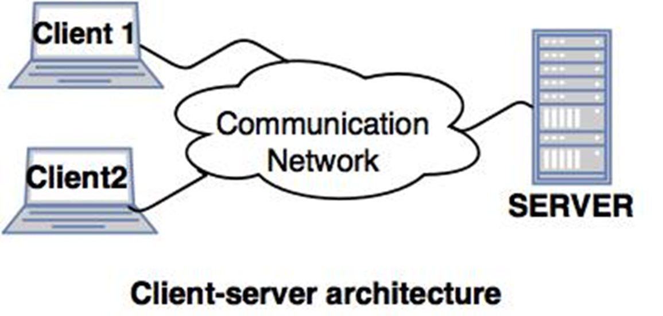
Application Architectures
Application architecture is the way in which the three basic functions of applications are distributed between clients and servers hardware

Slide 33
three General Models
Given these four broad sets of functions we can actually define three general models for application architectures:
Server-based
Client/Server
Client-based

Slide 34
Data access and
storage
Aplication
Logic
Presentation
Logic
Server-based
Mainframe or cloud with thin clients
Server
Server
Client
Client/Server
Software installed on clients and servers
Server
Server
Client
Client
Client-based
Stand-alone or P2P
Client
Client
Client

Slide 35
Server-based
Server
Client
Examples
Mainframes
Web applications
SaaS
Pros
Centralized management
Apps available form any client with access to server
Cons (mainframe)
Server= bottle neck
Strong investment
Hard to match supply of computational resource with demand

Slide 36
Client-based
Client
Examples
Text processors or spreadshteet software installed in laptops or PCs.
P2P environments
Pros
Lower capital requirements.
Easy to match supply of computational resources with demand.
Cons (mainframe)
Decentralized management
Difficulty in syncing data across clients.
Notes:
blockchain

Slide 37
Client / Server
Server
Client
Examples
Information systems with clients like...
ERP
BI
Mail
Pros
Distributed prcessing
Relatively easy to scale where needed
Allows HW and SW of various vendors and providers to work together.
Cons (mainframe)
Increased compleity
Requires middleware.
Notes:
blockchain

Slide 38
middleware
Client/Server Architecture and Middleware

Slide 39
middleware
Middleware is computer software that provides services to software applications beyond those available from the operating system. It can be described as “software glue”.
----Wikipedia
Software element that connects two other independent software elements.

Slide 40
Middleware
Authentication
Server
M
M
M
M
M
M
The glue that bonds the parts

Slide 41
Benefits of middleware
Middleware makes it easier for software developers to implement communication and input/output, so they can focus on the specific purpose of their application.
It connects the legacy systems with modern technologies.
It is a glue for close platforms to open platforms.
Let your systems speak the same language (in terms of communication protocol, file system, data format, etc.).
It enhances the overall performance, increases flexibilities, and provides more control.

Slide 42
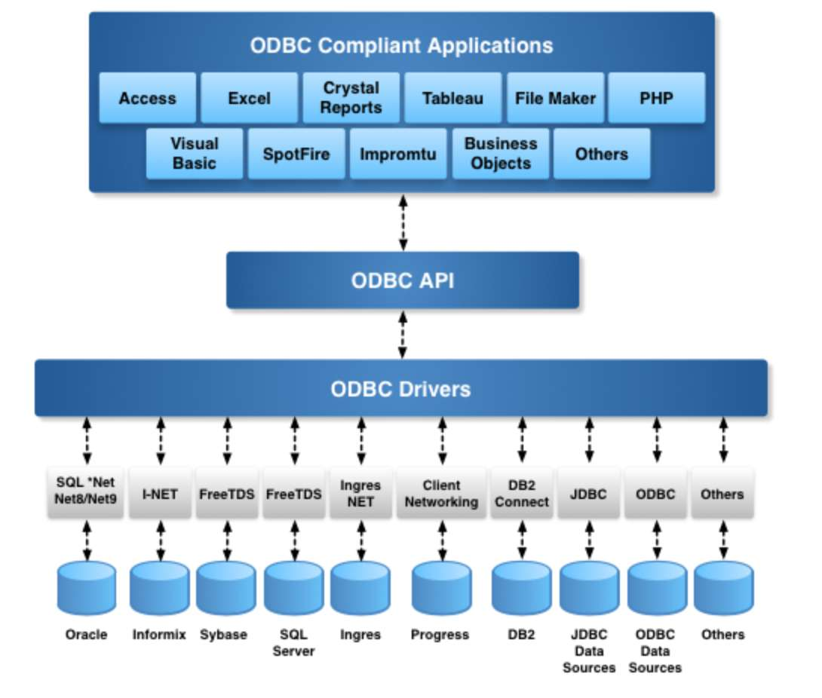
Examples of Middleware
Distributed Computing Environment (DCE);
Common Object Request Broker Architecture (CORBA)
REST APIs
Open Database Connectivity (ODBC);
Java Database Connectivity (JDBC);

Slide 43
Multi-tier Architectures
Multi-tier, multi-layer, or multi-level

Slide 44
Layering
Layering is one of the most common techniques that software designers use to break apart a complicated software system.
Breaking down a system into layers has a number of important benefits.
You can understand a single layer as a coherent whole without knowing much about the other layers.
You can substitute layers with alternative implementations of the same basic services.
Layers make good places for standardization.
Once you have a layer built, you can use it for many higher-level services.
You minimize dependencies between layers.

Slide 45
Multi-tier Architectures
The application logic is distributed across 2 or more servers.
Notes:
so far we’ve only had a client connect to a server
but we could have a client interacting with two or more servers.
that we called multi tier architectures.

Slide 46
Multi-tier Architectures
2-tier:
1 client and 1 server
Popular in simple LANs
3-tier:
1 client and 2 servers
Mail Client
Mail Server
Web browser
Web Server
Mail Server
BI (desktop)
Database Server
Application
Server (ERP)
Database
Server
ERP Client

Slide 47
Multi-tier Architectures
The application logic is distributed across 2 or more servers
n-tier:
more then 3 elements
Pros
Distributed workloads
Easy to scale
Flexibility
Cons
Complexity
Hard to troubleshoot
Web browser
Web Server
Application
Server (ERP)
Database
Server

Slide 48
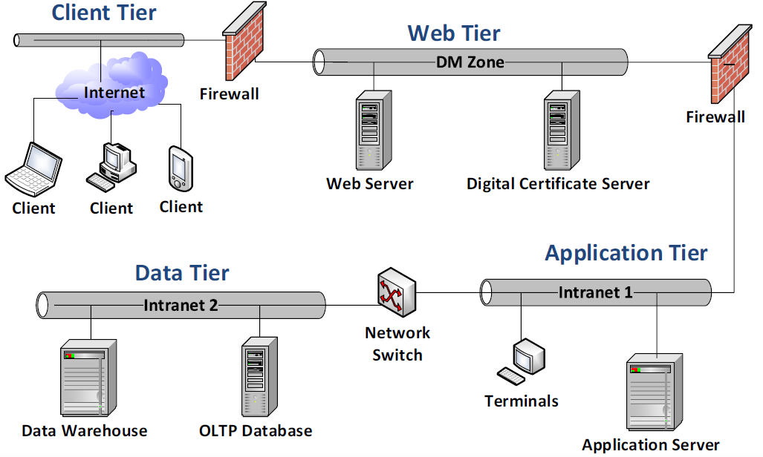
Online Transaction Processing (OLTP) Systems

Slide 49
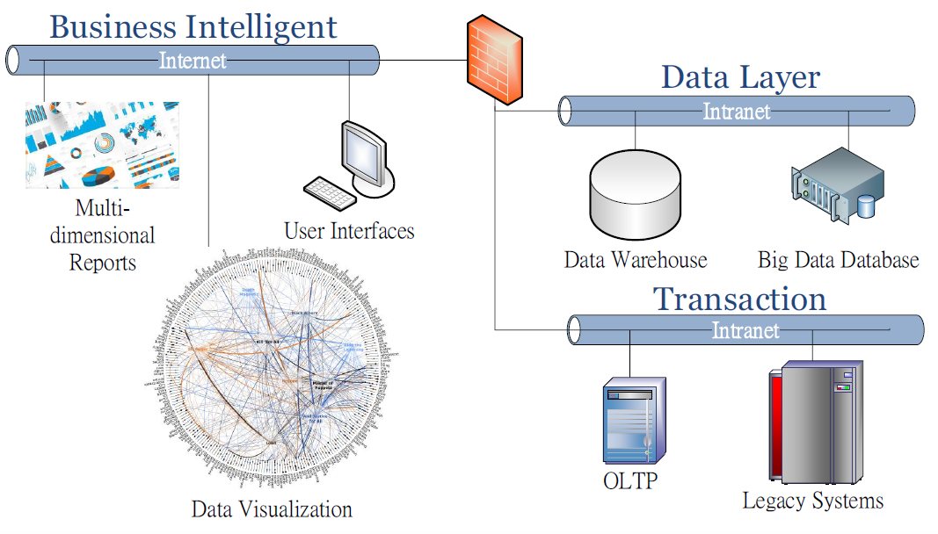
Online Analytical Systems

Slide 50
Centralized vs Decentralized Computing
Centralized Computing
Advantages: data integrity, more control
Disadvantages: single point of failure, higher cost
Decentralized (Distributed) Computing
Advantages: robustness, reduce workload
Disadvantages: consensus (Byzantine Generals Problem)
Enterprise computing is changing between centralized and decentralized over the year.

Slide 51
Summary
Enterprise Information System
Large-scale application software packages to support the complex business requirements.
A combination of many information systems to complete a task that is greater than the sum of its parts.
Enterprise Computing
Solutions for building and improving EIS.
Middleware
Connect the legacy systems with modern technologies.
Is a glue for close platform to open platform
Enterprise applications software (EAS)
is a software about the display, manipulation, and storage of large amounts of often complex data and the support or automation of business processes with that data.

Slide 52
Summary
Multi-tier Architectures
Layering
2-tier
3-tier
N-tier

